Slide 1


Doing Business in Latin America

Slide 2
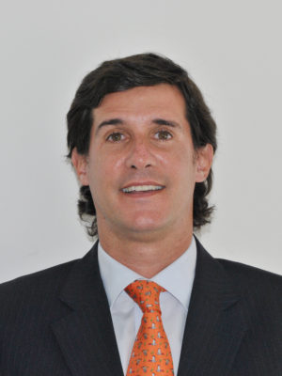

Mariano Carricart
Badeni, Cantilo, Carricart & Bilbao
Buenos Aires, Argentina
m.carricart@bccb.com.ar
Mariano E. Carricart was born in Buenos Aires on November 21, 1972. He graduated from the School of Law and Political Sciences of the Pontificia Universidad Católica Santa Maria de los Buenos Aires, Buenos Aires, in 1996. He received his Masters Degree in International Commercial Law (Banking and Finance) at Nottingham University, Nottingham, Great Britain, 2001. He graduated from the course on Corporate Finance at the Centre for Advanced Studies of the Law in 2003. He completed from the ”Corporate Specialization program”, a Pre-Master Course at Austral University, 1996. He is an Argentine collaborator for the World Bank, the International Finance Corporation and the Oxford University press co-publication of “Doing Business”. He has published a number of articles in specialized law journals. He is a member of the circuit of Seminars for the Masters Degree in Finance: “Legal Aspects of Finance” at CEMA University. He is a Member of the Bar Association of the City of Buenos Aires. He is a Member of the International Bar Association. On several occasions, he has been voted among the best lawyers under the age of 40.
Nació en la ciudad de Buenos Aires, el 21 de noviembre de 1972. Abogado egresado de la Facultad de Derecho y Ciencias Políticas de la Universidad Católica Argentina Santa María de los Buenos Aires, Buenos Aires,1996.Egresado del Curso de Finanzas Corporativas en el Centro de Estudios de Derecho Profundizado (CEDP), 2003. Egresado del Master of Laws in International Commercial Law (Banking and Finance) de Nottingham University, Nottingham, Reino Unido, 2001. Egresado del curso de Premaster, Programa de Profundización en la Problemática de la Empresa Universidad Austral, 1996. Colaborador argentino para la co-publicación del Banco Mundial, la Corporación Financiera Internacional y Oxford University Press “Doing Business” Understanding Regulation. Ha publicado diversos artículos en revistas especializadas de Derecho. Miembro del ciclo de Seminarios Maestría en Finanzas “Aspecto Legales de las Finanzas” de la Universidad del CEMA. Miembro del Colegio Público de Abogados de la Capital Federal. Miembro IBA. Elegido entre los mejores abogados menores de 40 años en reiteradas ocasiones.

Slide 3
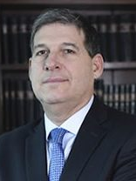

Juan Prado Bustamante
Llona & Bustamante Abogados
Lima, Perú
jprado@ellb.com.pe
Graduated from Universidad de Lima (1992), with masters’ in Comparative Jurisprudence from New York University (1993) and masters’ in International Banking Law from Boston University (1994). Partner of Estudio Llona & Bustamante Abogados since 2001, he joined the Firm as an associate in 1996. His practice area is centered in corporate and financial law, together with insurance and financial services, having participated in various privatizations and public offerings of state owned enterprises. Likewise, he has been member of the board of the Peruvian Securities Exchange Commission (CONASEV) today (SMV), arbitrator of the Controversies Chamber for the Lima´s Stock Exchange, as well as member of the board of the Lima´s Stock Exchange Clearinghouse (Cavali ICLV S.A) and presently for other companies in the country.
Abogado por la Universidad de Lima (1992) con maestría en Jurisprudencia Comparada por New York University (1993) y con maestría en Derecho Bancario Internacional por Boston University (1994). Socio de Estudio Llona & Bustamante Abogados desde el año 2001, se unió a la firma como asociado en el año 1996. Su práctica profesional se concentra en las areas de derecho corporativo y financiero, así como de seguros y servicios financieros, habiendo participado en diversas licitaciones y privatizaciones de empresas. Asimismo ha desempeñado los cargos de director de la Comisión Nacional Supervisora de Empresas y Valores (CONASEV) hoy SMV, arbitro de la Cámara de Controversias de la Bolsa de Valores de Lima, así como de la institución de compensación y liquidación del valores Cavali ICLV S.A. y de diversas empresas en el país.

Slide 4
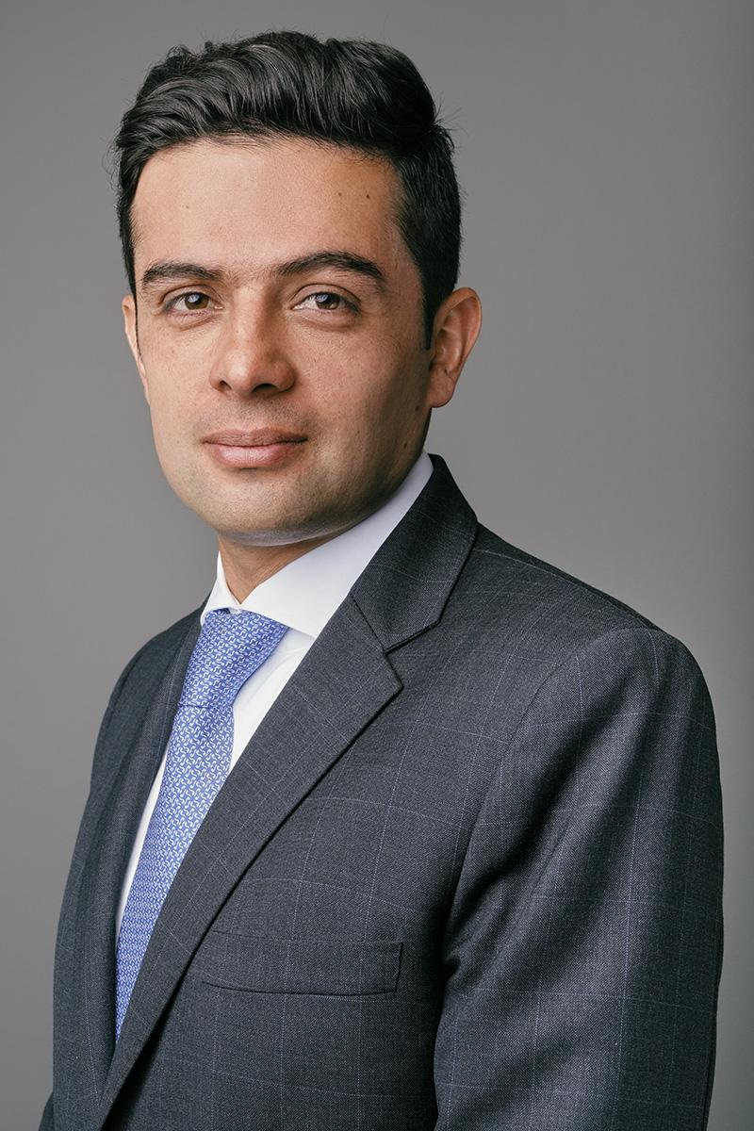

Julián Felipe Rojas R.
Pinilla, González & Prieto
Abogados
Bogotá, Colombia
jrojas@pgplegal.com
Julián Felipe Rojas Rodriguez is Manager of the Department of Corporate Law for Pinilla, Gonzalez & Prieto; his main area of practice is related to Civil and Commercial Law, although he currently is managing Labor and Education Law matters. He has worked as lawyer in charge of carrying out activities related to corporate law, such as mergers, acquisitions, incorporation of companies, etc. He currently is in charge of providing advice in Corporate Law Matters regarding mergers, acquisitions, incorporation of companies, secretariats of board of directors; in Contractual Law he advises on the determination and preparation of legal business and acts necessary not only for the development of real estate projects throughout the country, but in general for the participation of clients – national or foreign – of the firm in all the sectors of the economy by involving national and foreign corporate schemes and structures as well as the products offered by the financial or financial services entities. Julian is a lawyer from Universidad Externado de Colombia and specialist in Insurance law of the same University. He speaks English and Spanish.
Julián Felipe Rojas Rodríguez es Gerente del Departamento de Derecho Corporativo de Pinilla, González & Prieto; su principal área de práctica está relacionada con el Derecho Civil y Comercial, aunque actualmente se ocupa de asuntos de Derecho Laboral y Educativo. Ha trabajado como abogado encargado de realizar actividades relacionadas con el derecho corporativo, tales como fusiones, adquisiciones, constitución de sociedades, etc. Actualmente está a cargo de brindar asesoría en Materias de Derecho Corporativo en materia de fusiones, adquisiciones, constitución de sociedades, secretarías de junta directiva; en Derecho Contractual asesora en la determinación y preparación de negocios y actos jurídicos necesarios no solo para el desarrollo de proyectos inmobiliarios en todo el país, sino en general para la participación de clientes - nacionales o extranjeros - de la firma en todos los sectores de la economía al involucrar esquemas y estructuras corporativas nacionales y extranjeras, así como los productos ofrecidos por las entidades financieras o de servicios financieros. Julián es abogado de la Universidad Externado de Colombia y especialista en derecho de Seguros de la misma Universidad. Habla inglés y español.

Slide 5


Patricia Barcellos
Terciotti Andrade Gomes
Donato Advogados
Belém, Rio de Janeiro, &
São Paulo, Brazil
patriciabarcellos@terciotti.com.br
Patricia has 20 years of experience in corporate law, assisting national and international investors in Brazil. She has a strong practice in mergers and acquisitions, contracts and corporate law. Barcellos lived in the US for 4 years, where she became a licensed attorney in the State of Illinois and deepened her studies in M&A consulting.
Fluent in English and Italian, she graduated from the Federal University of Minas Gerais (UFMG), specialized in Business Administration at Fundação Getúlio Vargas (EAESP/FGV) and earned her Master’s degree in Tax Law from the University of São Paulo (USP). She also attended courses at Northwestern University Law School, in Chicago, and obtained an M&A Consultant certification from the De Paul University Alliance for Merger and Acquisition Advisors (AM & AA), in Chicago.
Graduação em Direito pela Universidade Federal de Minas Gerais, é especialista em Administração de Empresas pela Fundação Getúlio Vargas (EASP/FGV) e mestre em Direito Tributário pela Universidade de São Paulo (USP). Também frequentou disciplinas na Northwestern Law School, Chicago, EUA e obteve a certificação de Consultor de M&A pela Aliança para Conselheiros de Fusões e Aquisições (AM&AA) da De Paul University, Chicago, EUA.
Experiência de 20 anos de prática em consultoria corporativa, assessorando investidores nacionais e internacionais no Brasil, com forte atuação em fusões e aquisições, contratos e legislação societária, tendo residido nos EUA por 4 anos e sendo licenciada como advogada em Illinois.

Slide 6
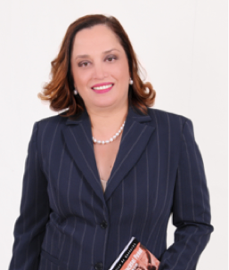

Marielena Ulloa
Ulloa & Asociados
San Pedro Sula & Tegucigalpa,
Honduras
marielena.ulloa@ulloayasociados.com
Degree in Law and Social Sciences - National Autonomous University of Honduras, Title of Lawyer issued by the Supreme Court of Justice, Exequatur of Notary issued by the Supreme Court of Justice No. 1422. Legal Director / Notary Coordinator of the firm Ulloa & Asociados, member of the Honduran Bar Association, Associate CSAP - International Registry of Certified Auditors (England), Practitioner - AccountAbility, England. Certified in the following programs: "Legal Aspects of International Business" (Georgetown University - INCAE) Managua, Nicaragua; "Management Program for Lawyers" Yale School of Management, New Haven, Connecticut; "Global Employer Latin America" Conference, Exhibitor for Honduras, Miami, Florida; Diplomat in Civil Procedural Law, Seminar In House on Transfer Pricing given by Seminarium, Seminar "Revenues and Departures of People", Goods and Means of Transport and Customs infringements and their sanctions, Interpretation of the ISO 9001: 2015, Internal Auditor ISO 19011 with focus on the ISO Standard 9001: 2015. Level: Internal Auditor.
Licenciada en Ciencias Jurídicas y Sociales – Universidad Nacional Autónoma de Honduras, Título de Abogado emitido por la Corte Suprema de Justicia, Exequátur de Notario emitido por la Corte Suprema de Justicia No. 1422. Socia Directora / Coordinadora de notario de la firma Ulloa & Asociados, miembro del Colegio de Abogado de Honduras, Associate CSAP - International Registry of Certified Auditors (England), Practitioner - AccountAbility, England. Certificada en los programas de: “Aspectos Legales de los Negocios Internacionales” (Universidad de Georgetown – INCAE) Managua, Nicaragua, Programa “Managment Program for Lawyers” Yale School of Management, New Haven, Connecticut. , Conferencia “Global Employer Latin America”, Expositora por Honduras, Miami, Florida, Diplomado en Derecho Procesal Civil, Seminario In House sobre Precio de Transferencias impartido por Seminarium, Seminario Ingresos y salidas de personas, mercancías y medios de transporte e Infracciones aduaneras y sus sanciones, Interpretación de la Norma ISO 9001:2015, Auditor Interno ISO 19011 con enfoque en la Norma ISO 9001:2015. Nivel: Auditor Interno.

Slide 7
Main types of entities admitted in the jurisdiction
Argentina | Brazil | Colombia | Honduras | Perú
Corporations (S.A.) and Limited liability (LLC) | Limited liability (Ltd.) and Corporation (S.A.) | Corporations (S.A.) Limited Liability Companies (LTD) Joint Stock Companies (S.A.S.) | Limited liability (Ltd.) and Corporation (S.A.) | Peruvian Law regulates several entrepreneurial forms which investors can use in order to operate their businesses. The main legal forms of companies according to Peruvian Law are: Joint Stock Corporations, (Sociedad Anonima), Closely Held Corporations, (Sociedad Anonima Cerrada), Publicly Held Corporations, (Sociedad Anonima Abierta), Limited Liability Companies, (Sociedad de Responsabilidad Limitada) Other types of forms to do business: Branches, (Sucursales), Associative Agreements (Consortium & Joint Venture)

Slide 8
Is there a free flow of foreign currency?
Argentina | Brazil | Colombia | Honduras | Perú
No. There are certain restrictions to the foregin currency coming in and out the country. Basically, any wire transfer coming in the country is converted into local currency. There are also restriction to send money out of the country | No. Foreign currency must be converted into Brazilian Reais. Brazilian Central Bank requires registries. Commercial Banks buy/sell foreign/Brazilian currency. | No, its subject to regulations and protocols to enter and exit the country by the Bank of The Republic and subject to control and intervention from the Superintendence of Societies | Resolution 531-12/2019 (Central Bank of Honduras) 1) Exporting from Honduras refers to file the declaration at the set time. 2) Bring money from abroad - It's usually through Banking 3) Buying foreign exchange (dollars) has a daily limit per person of up to $1.2 million for Exchange Houses and $520,000 for Banks 4) If there are restrictions to enter cash into the country, for reasons of money laundering. | Peruvian Law grants equal rights to foreign and local investors, guaranteeing free possession, use and disposition of local and foreign currencies in the country. No foreign exchange controls, registrations, approvals, or other similar restrictions relating to the remittance of foreign currency to or from Peru. No need of any governmental authority approval to undertake foreign exchange transactions, consequently, it may be used in any transaction provided that the parties agree to do so. Investors are entitled to transfer abroad its investment or profits-after tax are paid- in freely convertible currency, with no prior authorization by the Central Bank nor any other Peruvian Authority.

Slide 9
More than one shareholder required?
Argentina | Brazil | Colombia | Honduras | Perú
In general yes. But there is a type with only 1 shareholder called SAU | No. | Not in the case of Joint Stock Companies | No. In the last years they law changes to accept 1 shareholder or partner entities | There are no restriction for shareholders of Corporations. Peruvian Law grants equal rights and treatment to Local and Foreign investors. Minimum 2 shareholders, no minimum capital contribution, no restriction on the transfer of shares.

Slide 10
How long does it take to have the entity established?
Argentina | Brazil | Colombia | Honduras | Perú
3 months approximately Yet, if the shareholders are already registered the proceeding could last 15 days. | From 30 to 60 days | 5 to 6 days with all the documents in hand and a bank account created already | To create a newco 10 labor days, to put this company to operate 30 labor days (Tax, IHSS, Environmental issues) | Takes approximately 15 business days, counted from the date all documents and POAs are send to Peru and translated if the case.

Slide 11
 | Argentina | Brazil | Colombia | Honduras | Perú
Officers | Individuals or entities: Individuals only Non-residents admitted?: Yes | Individuals or entities: Individuals only Non-residents admitted?: Brazilian residency required | Individuals or entities: Individuals only Non-residents admitted?: Yes | Individuals or entities: Individuals only Non-residents admitted?: Yes, but they can’t be legal representatives | Individuals or entities: Peruvian legislation does not provide any restrictions for directors, CEO or representatives of corporations organized in Peru. These positions may be occupied by Peruvians and by non-resident persons. In case of a foreign CEO, he has to be present in the country and hold a resident’s visa. Non-residents admitted?: Yes
Board of Directors | Individuals or entities: Individuals only Non-residents admitted?: Yes, But the majority of the Board Of Directors shall have residency in Argentina | Individuals or entities: Individuals only Non-residents admitted?: Foreign residency admitted | Individuals or entities: Individuals only Non-residents admitted?: They can be part of the board, they have the same rights as nationals | Individuals or entities: Individuals only Non-residents admitted?: Yes, all of the Board can be foreign, but Article 209 of the Commercial code has to be Honduran and named Legal Representative for tax purposes | Individuals or entities: Non-residents admitted?: Yes

Slide 12
Is it required to have legal representative with legal residency in the country?
Argentina | Brazil | Colombia | Honduras | Perú
Foreign shareholders can appoint foreigners as legal representatives. Yet the representatives shall appoint local individuals to actually participate on corporate decisions | Yes, w/ special powers to receive service of process in the country. | It's not obligatory by law, but it is highly recommended that it takes a residence for practice purposes | Yes, w/ special powers to receive service of process in the country. Article 49 Tax Code | No restriction (only CEO must be present in country)

Slide 13
Can foreign employees be sent to work in the new company?
Argentina | Brazil | Colombia | Honduras | Perú
Yes. But the legal entity which is willing to bring foreign employees shall be registered before Migrations (RENURE) and a labor visa is require | Yes, but a visa and an employment contract will be required. | Yes a temporary visa that is longer than three months and a contract | Yes. They will need a Special Migratory Permit (PEP). | Foreigners, are allowed to work or provide services in Peru and must obtain the appropriate and prior immigration permit before the Peruvian Immigration Authorities.

Slide 14
Taxation of profits?
Argentina | Brazil | Colombia | Honduras | Perú
Yes. Dividends generated as from January 1, 2018. It is recommended to get accounting advise regarding this issue. | No. The entity in Brazil is taxed and profits flow to the shareholders free of taxes. But President and Congress want to change this.. | The income tax is 32% for the year 2020 | Yes. 25% Tax Income and 5% as Solidarity Contribution | Income: Corporate profits: 29.5% (Agriculture and agroindustry: 15%), Dividends: 5%, Royalties: 30%, Interest rate on loans from abroad: 4.9% Value Added Tax (VAT): 18% Financial Transactions Tax: 0.005% Temporary to net assets, applicable to the excess of S/.1,000,000: 0.4%

Slide 15
Name 1 COVID impact to the business in your country
Argentina | Brazil | Colombia | Honduras | Perú
Remote meetings are accepted during the lockdown period and for future meetings as well, as long as the by-laws set forth such a possibility. Electronic documents are becoming accepted in general. | Electronic documents and signatures largely accepted. | Virtuality in board meetings and more acceptance of the use of electronic signatures. Also, it has implemented work from home, which has given e-commerce a boost, It has also forced many sectors to adapt to the use of electronic devices. It has implemented digitalization in the private and public sector | Virtuality: PCM 33-2020 1) Of the extension of deadlines and relief as to tax obligations: 2) Administrative simplification in the implementation of electronic commerce mechanisms and electronic signature 3) Indefinite suspension of Employment Contracts is allowed for the duration of the Health Emergency and Curfew. By electronic means, all kinds of acts, contracts and any other type of legal business may be celebrated as long as it is possible to reliably show the will of the parties to carry out the legal business by this means. | Labor measures: Implementation of remote work (home office regulations), Leave with the benefit of being compensable, Suspension of labor activities, extraordinary withdrawal from the private pension fund, withdrawal of retirement or free provision from the Compensation Fund for Time of Services Tax aspects: the extension of terms for tax obligations, the extraordinary release of funds from the detraction account, Contractual aspects: Companies have move towards the digital environment Corporate aspects: Recognition of virtual board and shereholders meetings, even if not provided in the by-laws

Slide 16
A resource guide to doing business in Latin America can be found here

